Slide 1
Operation@Python
4110E237

Slide 2
Agenda
Python Strings
Slicing Strings
Modify Strings
Concatenate Strings
Format Strings
String Methods

Slide 3
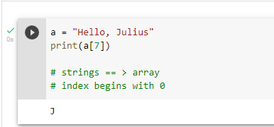
Strings in python are arrays of bytes representing Unicode characters:

Slide 4
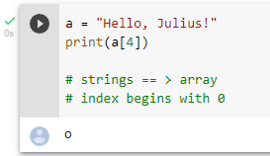
Strings are Arrays ==> access the element of array Python does not have a character data type, a single character is simply a string with a length of 1

Slide 5
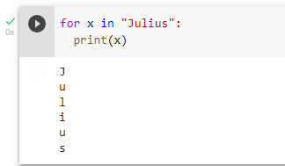
Looping Through a String

Slide 6
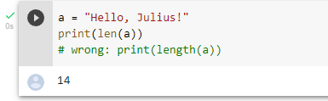
String Length:To get the length of a string, use the len()function

Slide 7
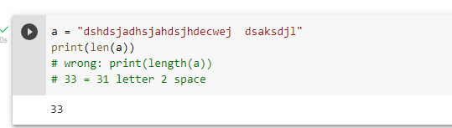
QUIZ: Tell me how many char appear in "dshdsjadhsjahdsjhdecwej dsaksdjl"

Slide 8
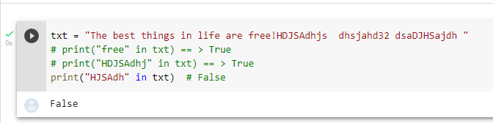
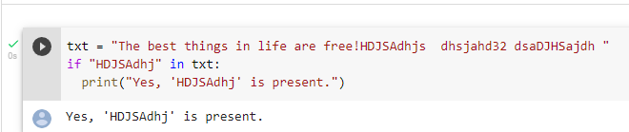
Check String :To check if a certain phrase or character is present in a string, we can use the keyword in.
keyword in vs if
True or False

Slide 9
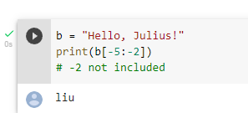
Negative Indexing

Slide 10
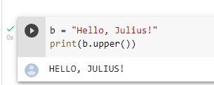
Python - Modify Strings
The upper() method returns the string in upper case:
The lower() method returns the string in lower case

Slide 11
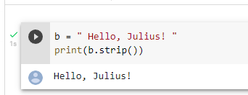
Remove Whitespace with strip() method The strip() method removes any whitespace from the beginning or the end

Slide 12
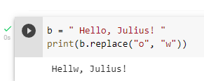
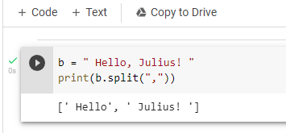
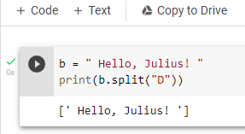
-The replace()method replaces a string with another string -Separator

Slide 13
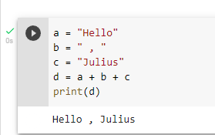
String Concatenation: To concatenate, or combine, two strings you can use the + operator.

Slide 14
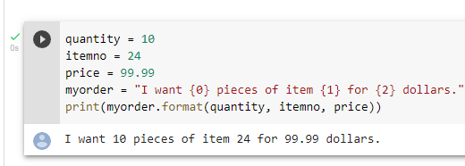
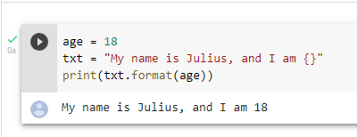
Python - Format - Strings

Slide 15
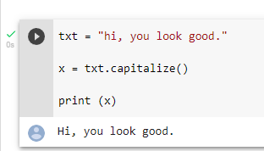
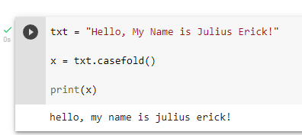
String Methods

Slide 16
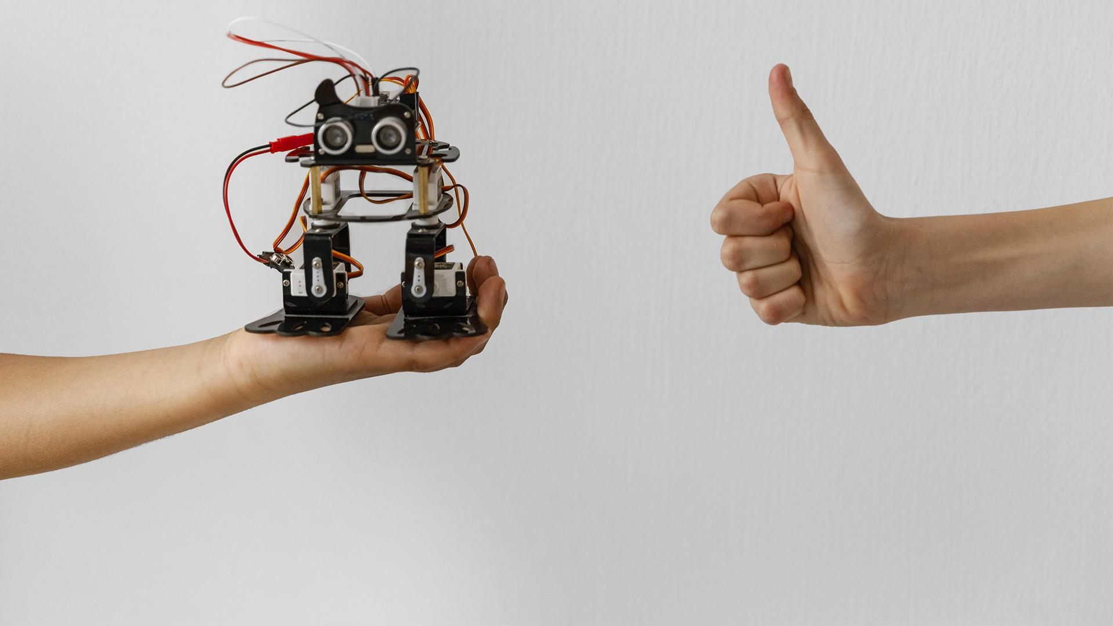
CHINESE NAME: 朱艾瑞
STUDENT ID: 4110E237
ENGLISH NAME: Saflor, Julius Erick Dela Cuesta
NICKNAME: 0001Player
Email: juliusericksaflor@gmail.com
GITHU: https://github.com/0001Player
THANK YOU!!

